Slide 1
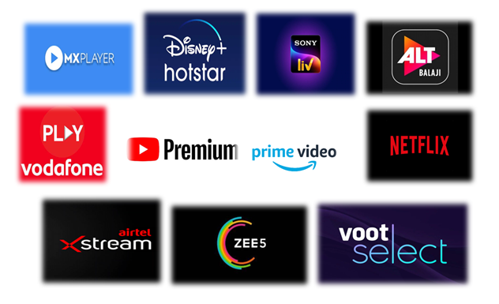
Growth of Over the top(OTT) and Factors Affecting It
Project by-
Komal Parab (12)
Krishna Barfiwala (10)
Maunika Shripati (19)
Shweta Singh (21)

Slide 2
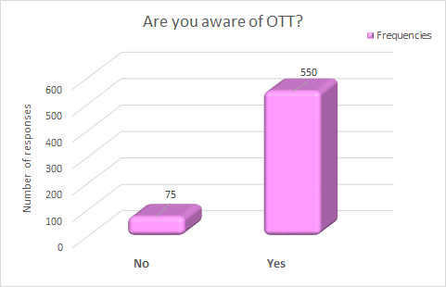
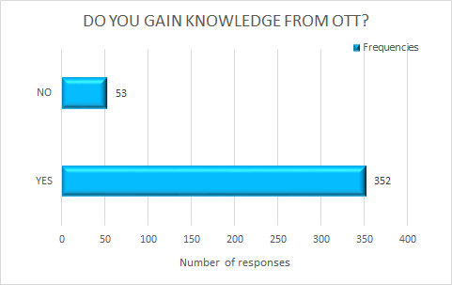
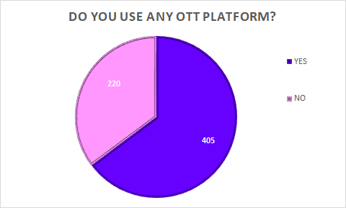
EXPLORATROY DATA ANALYSIS
AWARENESS ABOUT OTT PLATFORMS AND USAGE OF OTT PLATFORMS
Interpretation:
88% of the people are aware of OTT platforms of which 73.55% use them. From this it is seen that there are few people who do not use OTT platforms even though they are aware of them. 35% (220 people) of the sample do not use OTT. 87% of the viewers gain knowledge from the content they watch on OTT.

Slide 3
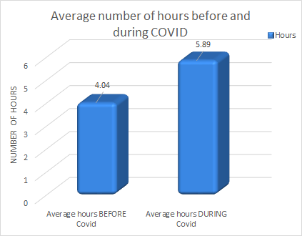
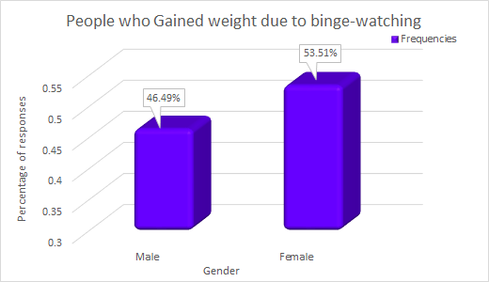
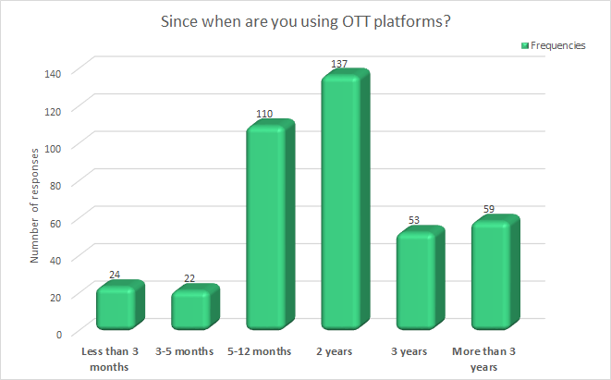
USING OTT PLATFORMS SINCE
VIEWING HOURS BEFORE LOCKDOWN AND DURING LOCKDOWN DUE TO COVID-19
GAINED WEIGHT DUE TO BINGE WATCHING
There is an increase of 39% subscriptions during Covid.
The average number of viewing hours increased from 4.04 before Covid to 5.89 per week during Covid.
Binge watch is an act of continuously watching for a long period of hours.
The percentage of Females who have gained weight is more than the percentage of Males who have gained weight due to Binge watching.

Slide 4
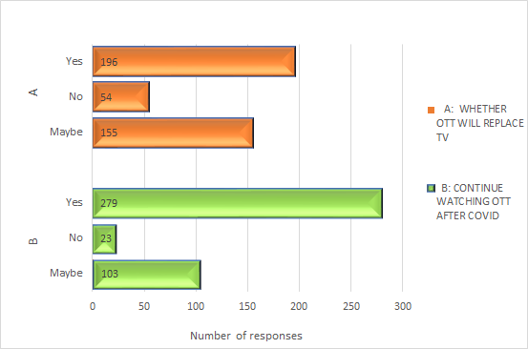
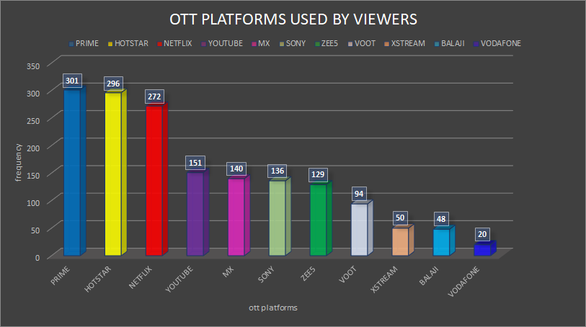
OTT PLATFORMS USED BY USERS
FUTURE OF OTT
Around 69% of the viewers are sure about continuing with OTT but only 48% feel that OTT will replace Television.
31% of the people are not sure about using OTT after Covid.
Amazon Prime, Disney+ Hotstar, Netflix, YouTube, MX Player are top 5 OTT platforms used by users.

Slide 5
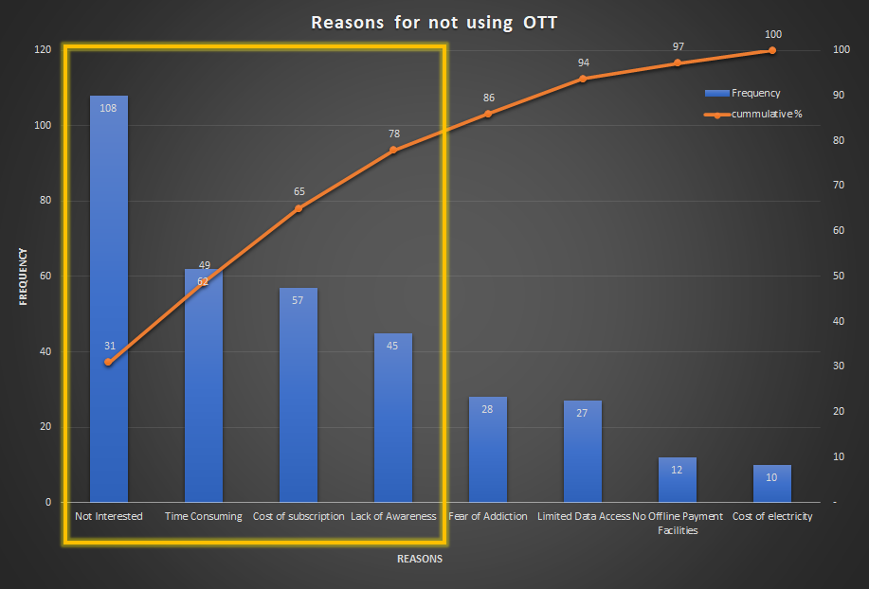
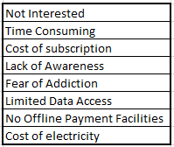
PARETO ANALYSIS:
Pareto analysis is based on the idea that 80% of a project's benefit can be achieved by doing 20% of the work or conversely 80% of problems are traced to 20% of the causes.
Objective: To Identify reasons for not using OTT
The variables used in the analysis are:
From Pareto Analysis, it is conclude that the main reasons for not using Ott are ‘Not Interested’, ‘Time consuming’, ‘Cost of subscription’, ‘Lack of Awareness’. To overcome these reasons, providers should focus on Awareness of OTT platforms, produce quality contnent and focus on providing different subsciption plans.

Slide 6
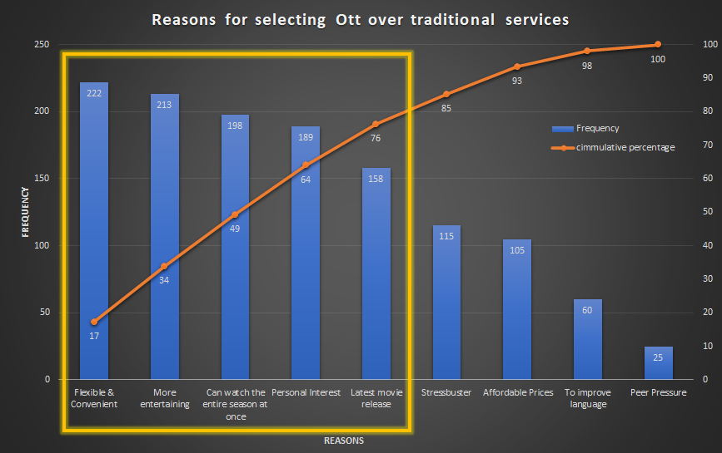
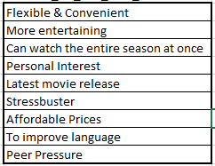
Objective: Reasons behind switching over to Online Video Streaming(OTT) from Traditional services.
The variables used in the analysis are:
From Pareto Analysis, it is concluded that the main reasons behind the growth of OTT over traditional services are its flexibility, convenience, more entertaining, the entire season can be watched at once, more interest in OTT content and availability of the latest movies.

Slide 7
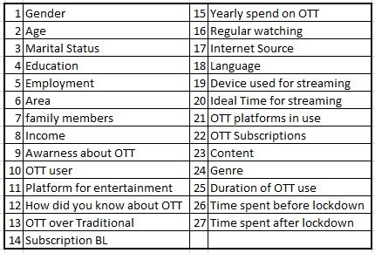
K-Means Cluster Analysis
Objective: To compare and classify the viewers based on the user's preference.
K-means cluster analysis is an algorithm that groups similar objects into groups called clusters. The endpoint of cluster analysis is a set of clusters, where each cluster is distinct from each other cluster.
Assumptions: The clusters are spherical and are of resemble in size.
Variables used in analysis are:

Slide 8
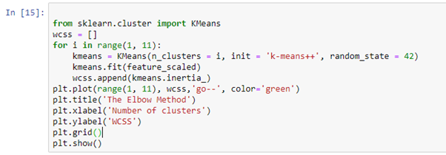
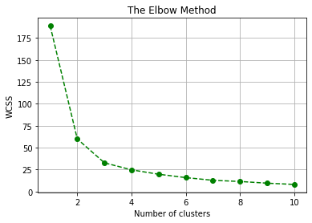

Calculating optimum number of clusters using elbow method:
In this method, the number of clusters are varies within a certain range.For each number, within-cluster sum of square (wcss) value is calculated and stored in a list. These value are then plotted against the range of number of clusters used before. The location of bend in the plot indicates the appropriate number of clusters.
From Fig 1. we choose the number of clusters as ‘3
Using the optimum no of clusters k-means model is trained :
Fig 1.

Slide 9
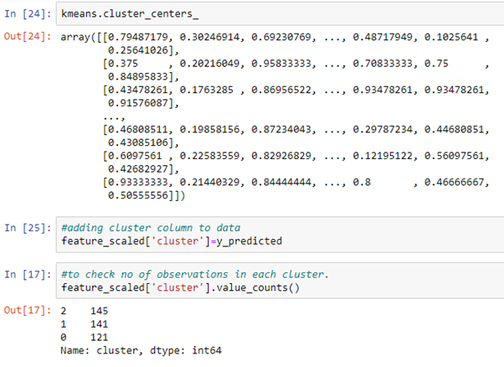
Calculation of cluster centroids and addition of cluster columns to original data:
The entire data is divided into 3 clusters and the clusters are named as Minimal viewer, Normal viewer, Extreme viewer

Slide 10
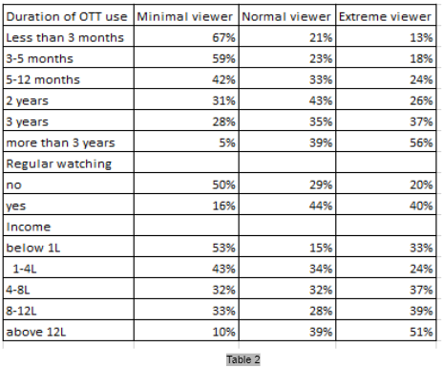
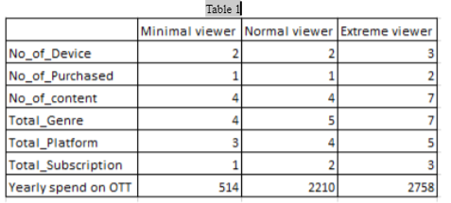
The table 1 shows that extreme viewers spend more money on the subscriptions of different types of OTT platforms, also they prefer to watch a variety of content, genre and they use more devices
Table 2 shows that minimal viewers have been using OTT platforms for less than three months and Extreme viewers have been using it for the past three years. Number of Minimal viewers are more in the below 1 lakh income category whereas Extreme viewers are more in 8-12 lakhs income category. Also Extreme viewers prefer to watch regularly.

Slide 11
XG Boost Analysis
Objective : To predict which type of subscribers will prefer the leading OTT platform(Amazon Prime).
XGBoost is a scalable ensemble technique based on gradient boosting that has demonstrated to be a reliable and efficient machine learning challenge solver. This work proposes a practical analysis of how this novel technique works in terms of training speed, generalization performance and parameter setup.
The target variable is stored in ‘Y’ and features in ‘X’. Y : User having subscription of Amazon Prime Y = 1 ; if yes = 0 ; otherwise.
Variables used in analysis are:

Slide 12
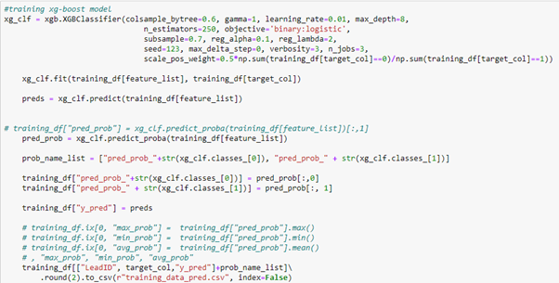
Splitting data into training and testing data sets.
Training the XG Boost model on train dataset.

Slide 13
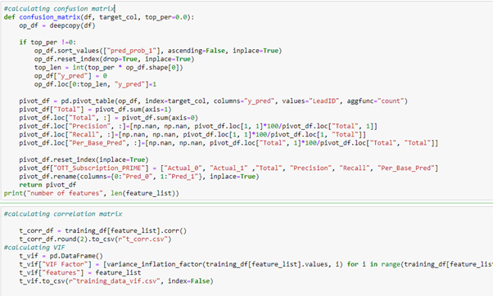
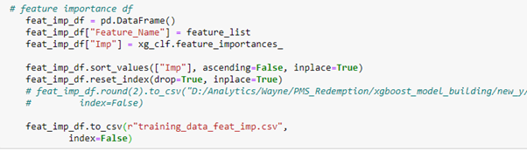
Calculation of Correlation matrix, VIF and Confusion Matrix.
Removal of features which were highly correlated, and which are having high VIF then again running the model using remaining features.
Top 15 features are selected using feature important function

Slide 14
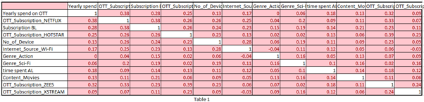
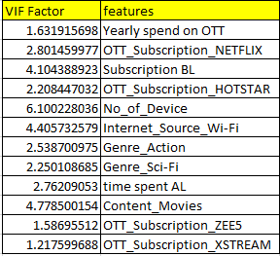
Table 3 is the final correlation matrix table.
Table 4 is indicating final VIF matrix,VIF for all the variables is under 8 hence there is little or no multicollinearity
Table 3

Slide 15
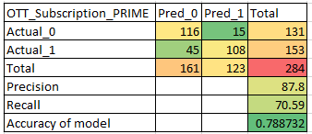
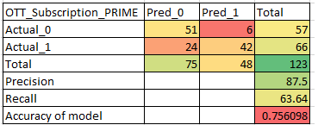
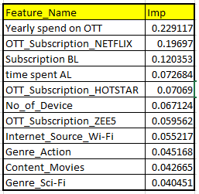
Table 5 is the confusion matrix for training data set: Table 6 is the confusion matrix for testing data set:
The Accuracy of the training set is 78.87% & the testing set is 75.61% .
Hence the results of the testing set are very close to the results of the training set hence we can say that our model is a good fit and ready for future prediction.
Significant features for this model are given in the table 7 along with their significance.
Table 5
Table 6
Table 7

Slide 16
Binary Logistic Regression
VARIABLE | VIF
Gender | 1.08
Age | 2.2
Marital status | 1.94
Education | 1.19
Employment | 1.42
Members family | 1.03
Living area | 1.03
Family Income | 1.13
Aware of OTT | 1.25
Objective: To study the socio- demographic factors that affect the usage of OTT platforms.
Logistic regression is the statistical technique used to predict the relationship between predictors (independent variables) and a predicted variable (the dependent variable).
Assumptions: Independent samples, Dependent variables should be binary, Little or no multicollinearity, Logistic regression assumes linearity of independent variables, Large sample size, No outliers.
Since all the VIF values for the variables are > 1 and < 5 which suggests the absence of multicollinearity.

Slide 17
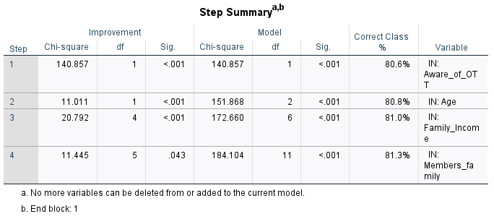
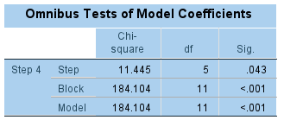
FORWARD LIKELIHOOD RATIO SELECTION:
SIGNIFICANCE OF THE NEW MODEL:
H₀: β₁= β₂=β₃= β₄ = 0
H₁: at least one β_{i} ≠ 0 (i=1,2,3,4)
Since P-value< 0.05, we reject H₀ and conclude that the model is fitting the data significantly better than a null model with no predictors.
There happens to be 4 steps as described in the above table. Awareness about OTT, Age and Family Income are highly significant whereas Members in a family are significant but not as high as the above variables.

Slide 18
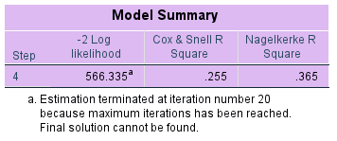
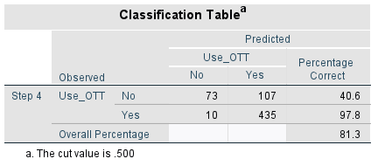

VARIATION EXPLAINED
CONFUSION MATRIX
The total variation in the model explained ranges from 25.5% to 36.5%. The independent variables explain roughly 36.5% of the variation in the dependent variables.
H₀: The REDUCED model is a good fit
H₁ : The REDUCED model is not a good fit
Here p-value: 0.850 > 0.05. Hence not rejecting H₀ and concluding that the reduced model is a good fit.
  As the model adds significant variables in the model, the prediction percentage increased from 80.6% to 81.3% in 4 steps. The model fitted can correctly classify 81.3% of the cases. Hence any value above 80% is called a good model.
HOSMER AND LEMESHOW TEST (GOODNESS OF FIT)

Slide 19
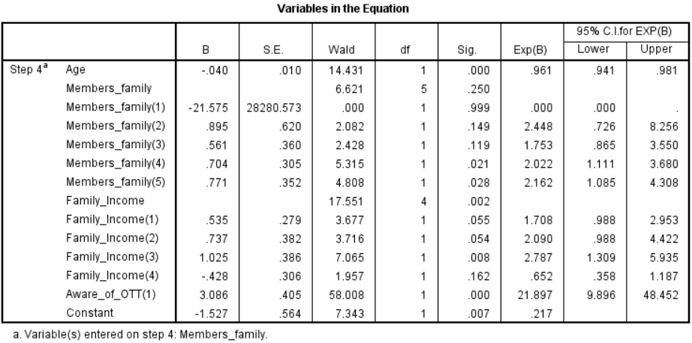
FITTED MODEL
f(x) = -1.527 (constant) - 0.04 (x1) -21.575(x21) + 0.895(x22) + 0.561(x23) + 0.704(x24) + 0.71(x25) + 0.535(x31) + 0.737(x32) + 1.025(x33) -0.428(x34) + 3.086(x4)
Where,
x1 = Gender,
x21= 1 Member Family
x22 = 2 Members Family
x23 = 3 Members Family
x24= 4 Members Family
x25= 5 Members Family
x31= Annual Family Income (4-8 Lakhs)
x32= Annual Family Income (8-12 Lakhs)
x33= Annual Family Income (More than 12 Lakhs)
x34= Annual Family Income (Below 1 Lakh)
x4= Aware about OTT (Yes)
Note:
The Members in the family variable are compared to ‘More than 5’ Family Members.
The Annual Family Income is compared to Annual income of Rs. 1-4 Lakhs.
Awareness about OTT is compared to people who are not aware of OTT platforms.

Slide 20
Odds ratio:
Estimate (B)
The odds of an older person using OTT platforms is low.
A person with 4 and 5 family members are more likely to use OTT.
Individuals with annual family income between ‘Below 1 Lakh’ are least likely to use OTT platforms.
Respondents who were aware of OTT platforms were highly likely to use OTT platforms.
H₀: Individual independent variables are significant
H₁: Not H₀
For variables, whose p value<0.05 indicate they did not add to the model significantly.
Age, Members in family (4), Members in family (5), Family Income above 1 Lakhs, Awareness about OTT platforms are all significant as their p value is <0.05.
An Exp(B) value over 1.0 signifies that the independent variable increases the odds of the dependent variable occurring. An Exp(B) under 1.0 signifies that the independent variable decreases the odds of the dependent variable occurring, depending on the decoding that is mentioned on the variables details before.
For an additional year in age, the odds of a person using OTT platform is lowered by a factor of 0.961.
Odds Ratio is a measure of association representing the odds that a person with annual family income ‘4-8 Lakhs’ is 2 times more likely to use OTT platforms than people with ‘1-4 Lakhs’ annual family income.
A person with 5 family members is more likely to use an OTT platform than a person with a More than 5 members.
People who are aware of OTT platforms are 22 times more likely to use OTT platforms than people who are not aware of OTT.
Wald Statistic-

Slide 21
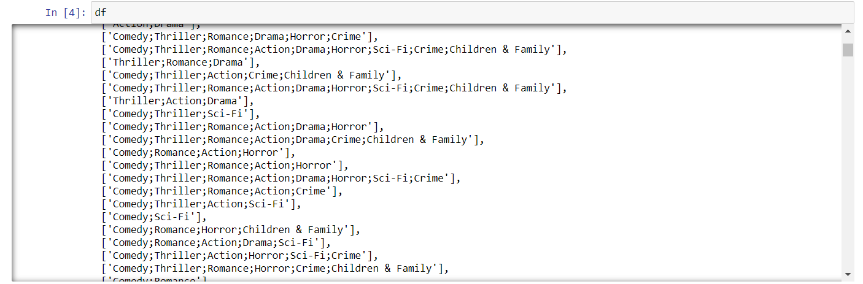
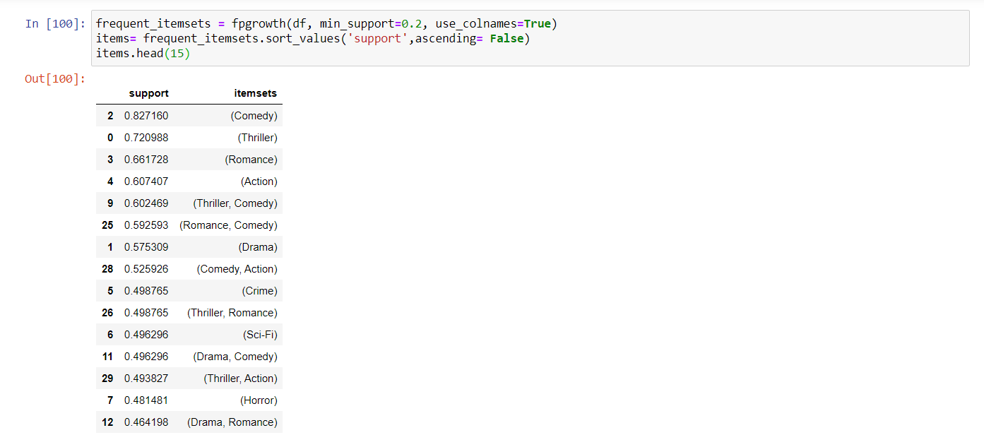
APRIORI ALGORITHM
Support
Apriori is an algorithm for frequent item set mining and association rule learning over relational databases. it uses prior knowledge of frequent itemset properties.
Objective: To understand the association and frequency between different genres
The dataset looks like,
The support for comedy is the highest indicating most viewers want to watch Comedy genre followed by Thriller and Romance. Viewers also like to watch Thriller and Comedy together and Romance and Comedy together.

Slide 22
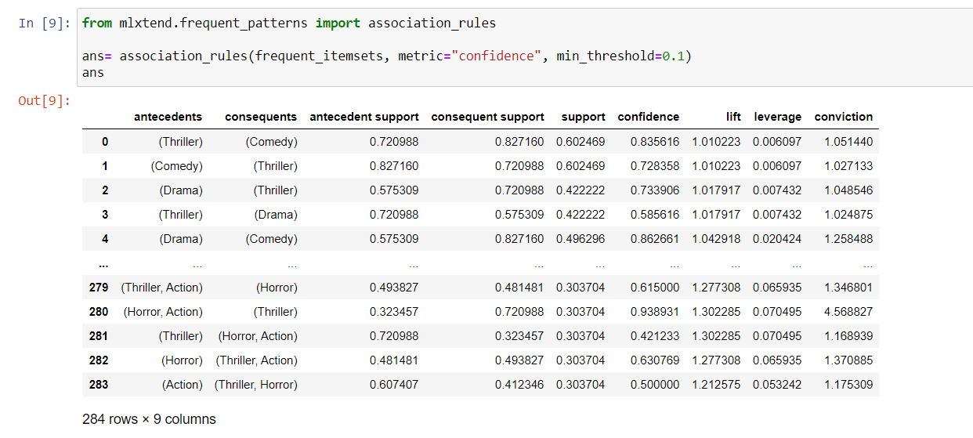
This table also gives the Genre - Thriller and Comedy are preferred more. Drama is the next Genre highly preferred.
Viewers who like to watch Comedy, Thriller, Crime also watch Action and Horror. Viewers who like to watch Drama and Horror will preferably watch Romance and Crime.

Slide 23
CHI-SQUARE
 | Null Hypothesis | Alternative Hypothesis
Sr.no | Ho | Ha | Chi-square value | P-value | Interpretation
Case 1 | There is no association between Gender and Awareness of online streaming (OTT) | There is an association between Gender and Awareness of online streaming (OTT) | 2.48 | 0.12 | Therefore, we do not reject Ho and conclude that there is no association between Gender and Awareness of online streaming.
Case 2 | There is no association between Marital Status and Awareness of online streaming (OTT) | There is an association between Marital Status and Awareness of online streaming (OTT) | 49.84 | 0.000000000002 | Therefore, we reject Ho and conclude that Unmarried people are more Aware of OTT than Married.
Case 3 | There is no association between Education Status and Awareness of OTT. | There is an association between Education Status and Awareness of OTT. | 71.90 | 0.000000000002 | Therefore, we reject Ho and conclude that in our study out of 305 undergraduates 280 people are aware of OTT.

Slide 24
Sr no. | Ho | Ha | Chi-square value | P-value | Interpretation
Case 4 | There is no significant difference between Employment and Awareness of OTT. | There is a significant difference between Employment and Awareness of OTT. | 0.52 | 0.47 | Therefore, we do not reject Ho and conclude that there is no association between Employment and Awareness of online streaming.
Case 5 | There is no significant difference between Income and Awareness of OTT. | There is a significant difference between Income and Awareness of OTT. | 28.34 | 0.00001 | Therefore, we reject Ho and conclude that people who have income between 1-4 lakhs and 4-8 lakhs are more aware of OTT.
Assumptions of Chi-Square:
Independence of observations
Each observed frequency is generated by a different individual
Size of expected frequencies
Chi-Square test should not be performed when the expected frequency of any cell is less than 5
Interpretation:
Awareness of OTT is not associated with Gender and the Employment status of an individual. Whereas Awareness of OTT is associated with Marital status, Education and Income.

Slide 25
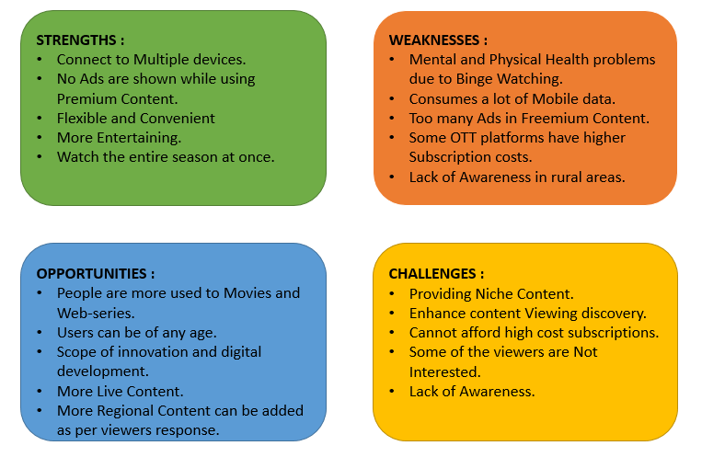
SWOC ANALYSIS
From the analysis it is observed that OTT has allowed people to watch their favorite shows on a wide range of multiple devices.
It is also very flexible and convenient to use.
Higher subscription cost is the major reason for the users for not using OTT and due to binge watching by people, there is a high risk of mental and physical health issues.
Creating more interesting content along with keeping it original is very much essential for staying in the race for each platform.
By taking the challenges as opportunities there should be more movies and web-series as viewers want a variety of entertaining content to suit every mood.
Lack of Awareness in rural areas may be the reason of network connectivity.

Slide 26
Conclusion: Suggestions
Collect user’s feedback when they delete accounts to deliver a better streaming experience to other customers.
Produce more Advertisements for better reach.
Prices for mobile data can be lowered so that more people can take subscriptions and can watch videos.
Add more incentives for OTT subscribers in the Rural area.
During the Covid period, everything is being escalated to online. OTT platforms (like YouTube) owners can provide subscriptions for a lower rate in the Rural area for educational purposes. This will create awareness among the areas in the Rural areas. Eventually more people will opt for OTT.
OTT platform owners can give additional perks to such customers who are not sure about continuing using OTT by giving them an extra month of usage or recommending better videos as per the customers interest.
Focus more on the originality of the shows.
Speed up content discovery by creating stories.

Slide 27
Scope
There are so many streaming services like music streaming, video streaming, live video streaming, etc. This research study is limited to Video Streaming platforms only, so this study can be explored further to other streaming services. Other topics including freemium can also be included. App distribution by freemium and subscription based can be done.
Large mobile penetration in developing countries and cheap data prices is one of the reasons for streaming being more popular these days. The relationship between data consumption and the use of streaming services can be studied.
Future research should examine the impact of how consumers watch entertainment and explore different ways that Cable/DTH or streaming services are used.
One should do the survey on why people are preferring a particular subscription.
Attributes like UI design, Application Designing (graphics, animations, etc.) can be taken into consideration for further study.
This study can be done using samples of equal proportions of all age groups. Because this project was done during Covid, the responses collected were not in equal proportions of all age groups due to which the data was skewed.

